Slide 1
An analysis of Antibiotic Enhancement Using
J’Laine Tindell, Kayla Easter, and Emily Eary

Slide 2
Project goal
Store microbiology data in a database
Analyze the dating using Python
Generate visual comparisons between treatments

Slide 3
Resources
Python
SQL
Scientific data set

Slide 4
Data pipeline Overview
Experiment
Data File
SQL
Report
Graph
Python

Slide 5
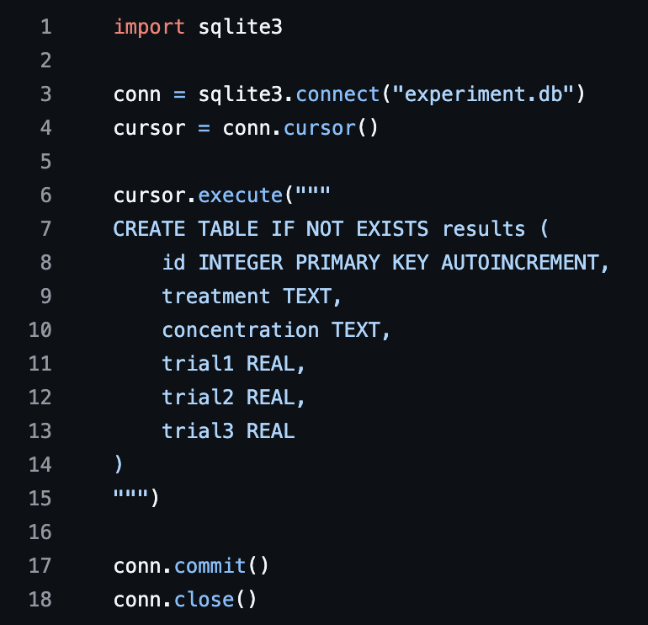
Database Setup (SQL)
Imported SQLite database
Created a table called “Results”
Stored data:
Treatment
Concentration
Trial 1, Trial 2, and Trial 3
This allows structured storage rather than disorganized spread sheets.

Slide 6
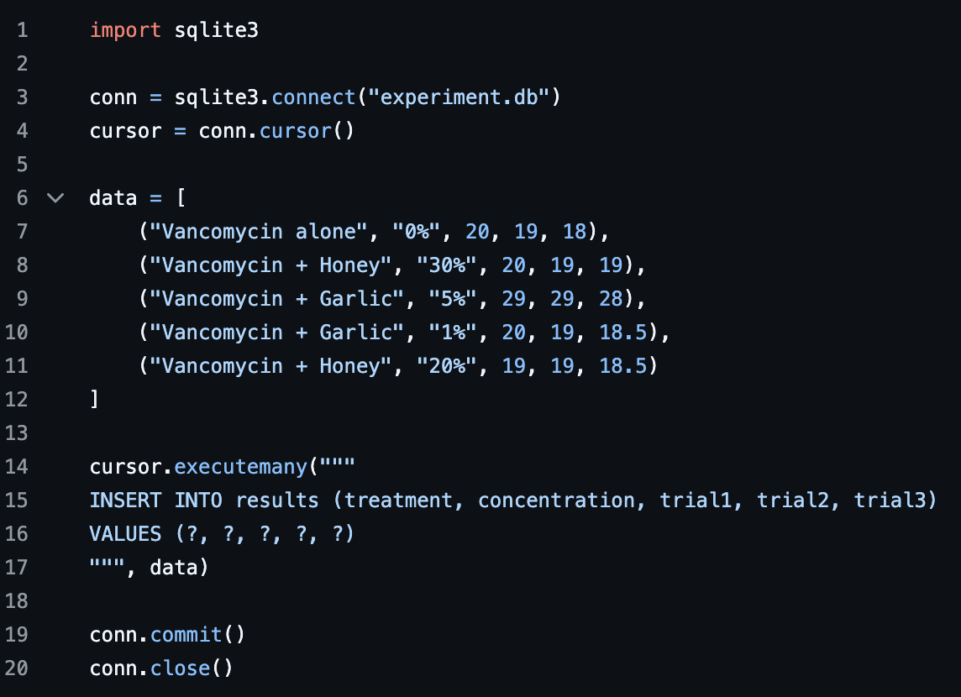
Data Insertion
Each line of data has 5 fields
Treatment Combination (vancomycin + added substance)
Concentration of Added Substance (honey or garlic)
Measurement from Trial 1
Measurement from Trial 2
Measurement from Trial 3
Data was inserted into SQL database from previous step.

Slide 7
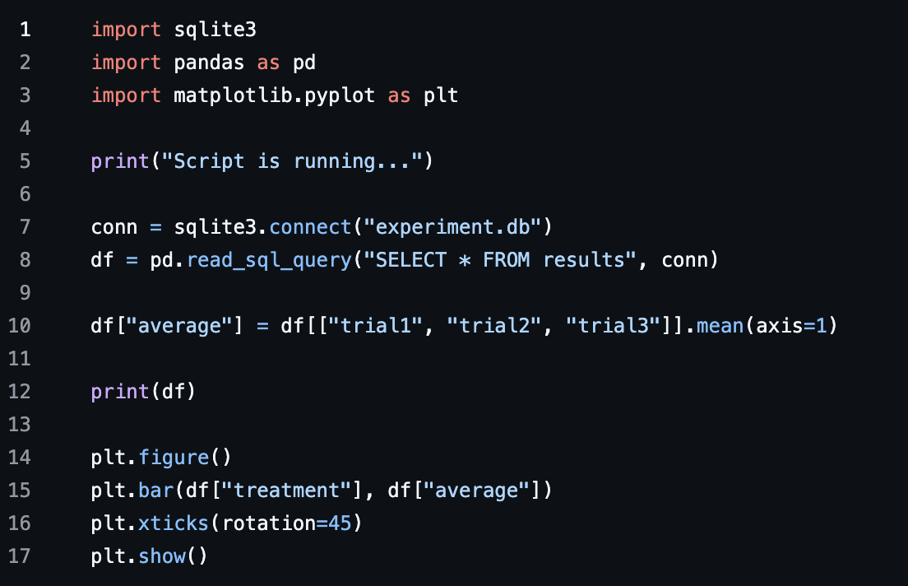
Python Data Analysis
SQLite was connected to panda. (7)
Data pulled from database and loaded into Padas DataFrame (df)
The average measurement for each treatment was calculated. (10)
The full Data frame was printed. (12)
Data was printed including treatment, concentration, trials 1-3, and now the averages.
A bar chart was created of treatment vs. average. (14-17)
X-axis: treatment condition
Y-axis: average measurement.

Slide 8
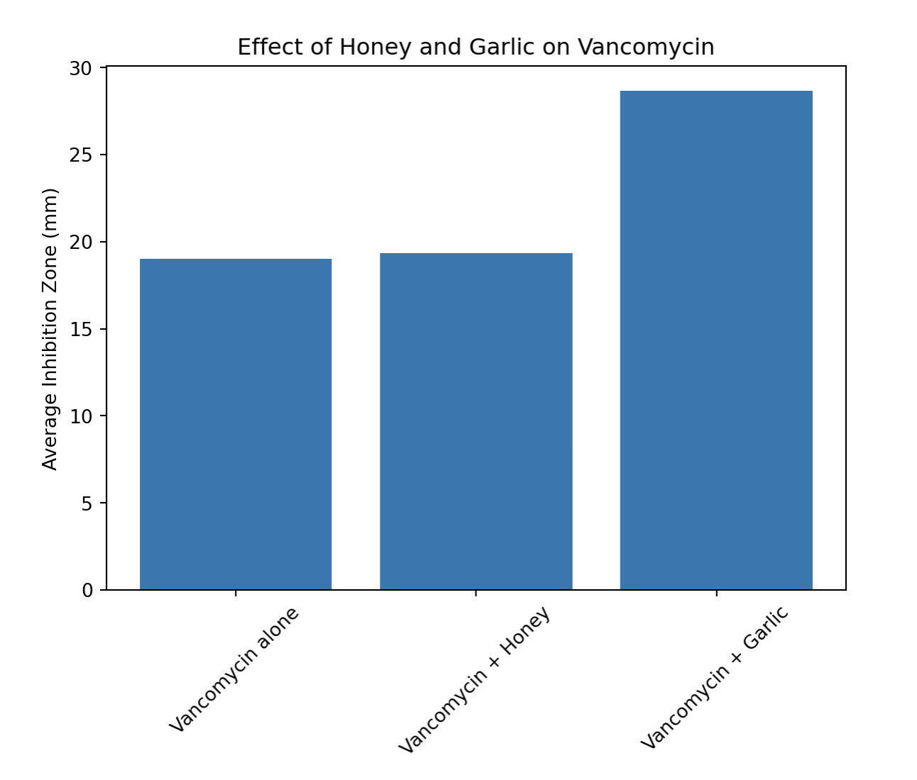
Data visualization
Bar graph generated by Python
Shows the comparison between the average inhibition zones and the treatment trials.

Slide 9
Why this matters
SQL stored data in a structured database rather than a messy spreadsheet.
Python took this database and computed averages. This reduced calculation errors among statistical analysis allowing it to be reproducible.
Python took the data and generated a bar graph allowing for easy visualization.

